Slide 1
Using Direct And Indirect Discourse

Slide 2
Message Relay

Slide 3
Unlocking of Difficult Terms

Slide 4
Let’s Boogie!!!

Slide 5
Q | K | B | O | O | I | Z | D | L | H
U | O | U | P | M | N | I | I | L | C
O | D | I | S | C | O | U | R | S | E
T | I | K | H | F | N | R | E | A | E
A | S | U | S | A | Y | J | C | A | P
T | Q | W | U | L | T | R | T | R | S
I | P | X | P | J | G | O | A | E | D
O | S | E | A | Y | U | T | U | E | B
N | R | N | I | C | M | O | U | Q | N
I | N | D | I | R | E | C | T | A | O

Slide 6
Words in the Box! PTS
Quotation 3
Discourse 2
Reply 2
Speech 1
Direct 1
Indirect 1
10

Slide 7
Base from the body language activity, tell the message of the pictures.

Slide 8

The police officer signalled that Mr Driver had to stop.

Slide 9
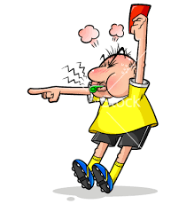
The referee shouted that Ricky was foul.

Slide 10
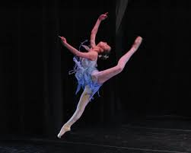
The ballet dancer expressed that it was her best performance.

Slide 11
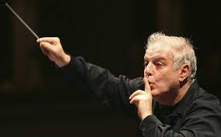
The conductor directed the singers to sing softer.

Slide 12
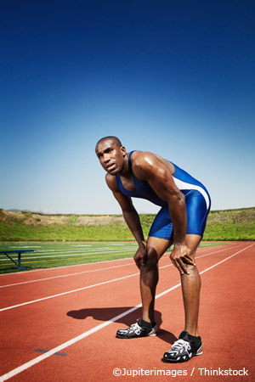
The athlete sighed that he was tired.

Slide 13
The police officer signaled, “Stop, Mr. Driver!”
The referee shouted, “Foul! Ricky! ”
The athlete sighed, “I’m very tired!”
The conductor directed the singers, “Sing softer!”
The ballet dancer expressed, “This is my best performance!”

Slide 14
The police officer signaled that Mr. Driver had to stop.
The referee shouted that Ricky was foul.
The athlete sighed that he was tired.
The conductor directed the singers to sing softer.
The ballet dancer expressed that it was her best performance.

Slide 15
Given Statements | Expected Answers
Direct Discourse/Speech | Indirect Discourse/Speech
A. Given Messages The police officer signaled, “Stop, Mr. Driver!” The referee shouted, “Foul! Ricky! ” The athlete sighed, “I’m very tired!” The conductor directed the singers, “Sing softer!” The ballet dancer expressed, “This is my best performance!” | B. Relayed/Reported Messages The police officer signaled that Mr. Driver had to stop. The referee shouted that Ricky was foul. The athlete sighed that he was tired. The conductor directed the singers to sing softer. The ballet dancer expressed that it was her best performance.

Slide 16
Change the following into indirect speech.
1. He said, ‘Let’s wait for her return.’
He proposed that they should wait for her return.
2.Alice said, ‘How clever I am!’
Alice exclaimed how clever she was.
3.. ‘Which way did she go?’ asked the young man.
The young man asked which way she had gone.
4.He said to me, ‘Where are you going?’
He asked me where I was going.
5.‘Please wait here till I return,’ she told him.
She requested them to wait there till she returned.

Slide 17
Change the following into indirect speech.
1.The girl said, ‘It gives me great pleasure to be here this evening.’
The girl said that it gave her great pleasure to be there that evening.
2. The man said, ‘I must go as soon as possible.’
The man said that he must go as soon as possible.
3. She said, ‘I don’t want to see any of you; go away.’
She said that she did not want to see any of them and asked them to go away.
4. The teacher says, ‘If you work hard, you will pass.’
The teacher says that if you work hard you will pass.
5. He said, ‘I have won.’
He said that he had won.

Slide 18
Assignment:
Turn the following sentences into indirect speech.
1. ‘What do you want?’ she asked him.
2. ‘Are you coming with us?’ he asked me.
3. He asked, ‘When do you intend to make the payment?’
4. ‘Do you come from China?’ said the prince to the girl.
5. The poor man exclaimed, ‘Will none of you help me?’

Slide 19
Answer:
1. She asked him what he wanted.
2. He asked me if I was coming/going with them.
3. He enquired when I/he/she intended to make the payment.
4. The prince asked the girl if she came from China.
5. The poor man exclaimed whether none of them would help him.

